Slide 1

Segmented Logistic Model 분석
서울대학교 박태성 교수
생물정보통계 연구실
박사과정 구태완 석사과정 한결희, 이도은
학부과정 고영현, 김학용, 김태현, 정혜원

Slide 2
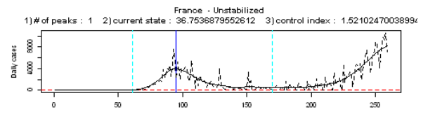
Classification by # of Waves
Wave 수에 따른 국가 분류를 진행
분석 대상 국가 : 167개국 (9월 22일 기준)
# of breakpoints를 기준으로 wave 수를 계산함
# of waves | 1 | 2 | 3 | 4
# of country | 70 | 68 | 27 | 2

Slide 3

Classification by # of Waves
# of breakpoint = 1
Day of cumulative cases $≥$50
Not a break point
1st break point

Slide 4
Segmented Logistic model
1. Segmented Logistic model with sequential fitting method
연속성을 만족하는 segmented logistic model
2. Separately Fitted Logistic model
각각의 wave에 대해 독립적으로 logistic model을 적용.

Slide 5
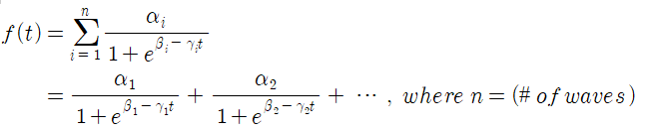
Segmented Logistic model with sequential fitting method
Procedure
1) Peak Detection Algorithm을 이용하여 Breakpoint를 찾음.
2) 각각의 breakpoint마다 순차적으로 모형을 적합시킴.

Slide 6
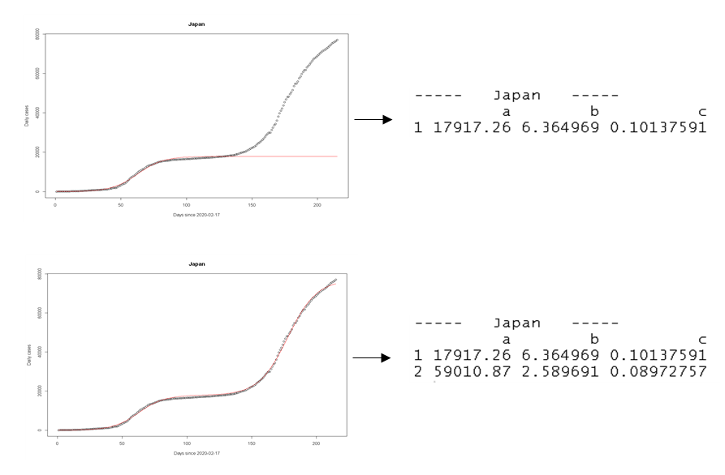
Segmented Logistic model with sequential fitting method
These two fittings are sequentially performed.

Slide 7
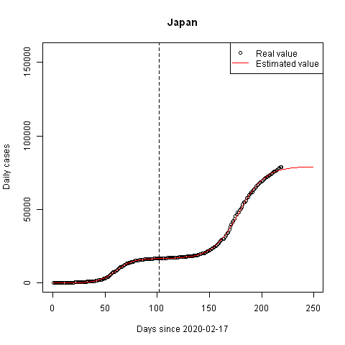
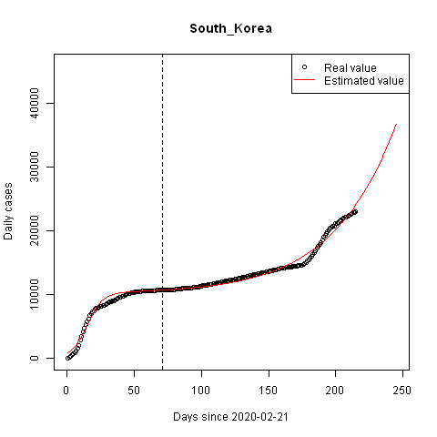
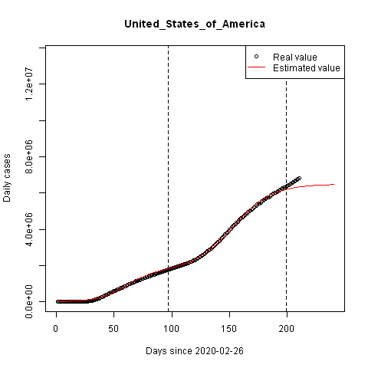
Segmented Logistic model – Cumulative Cases

Slide 8
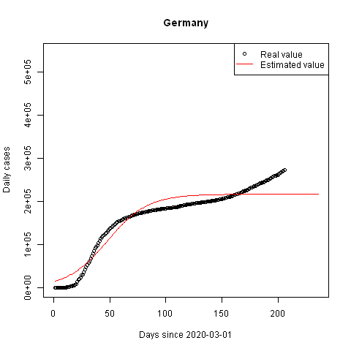
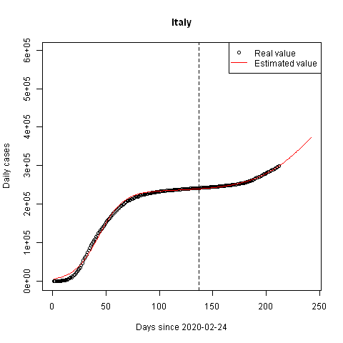
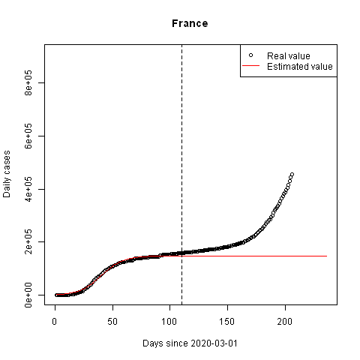
Segmented Logistic model – Cumulative Cases

Slide 9
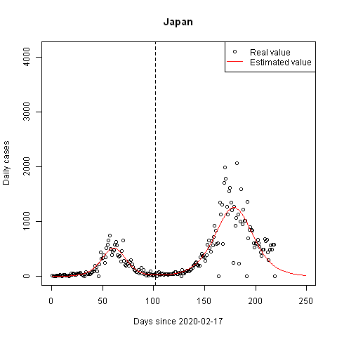
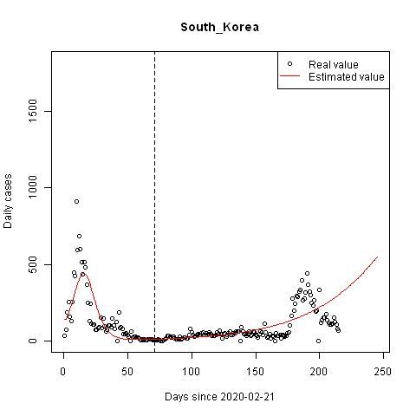
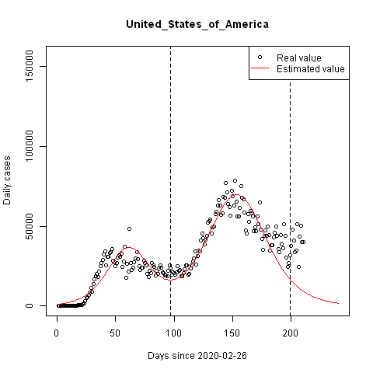
Segmented Logistic model – Daily Cases(converted)

Slide 10
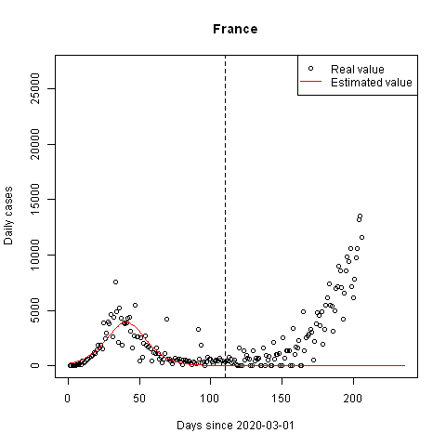
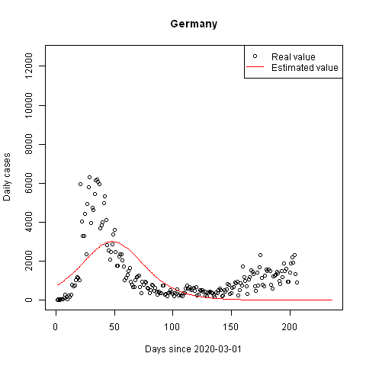
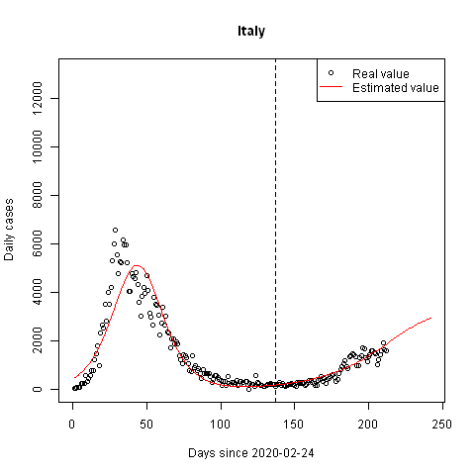
Segmented Logistic model – Daily Cases(converted)

Slide 11
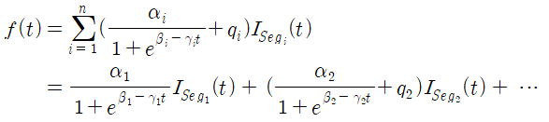
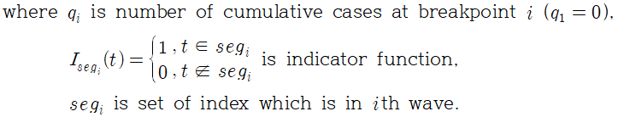
Separately Fitted Logistic model
Procedure
1) Peak Detection Algorithm을 이용하여 Breakpoint를 찾음.
2) 각각의 wave partition에 대해 독립적으로 모형을 적합시킴.
=> 함수의 연속성이 보장되지 않음.

Slide 12
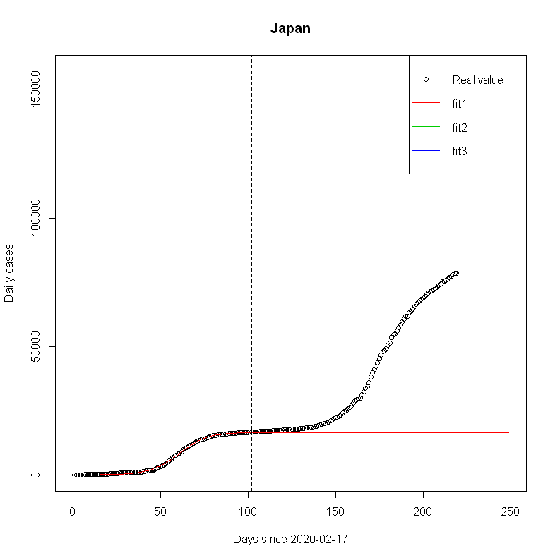
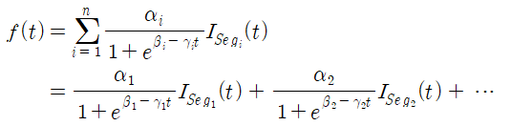
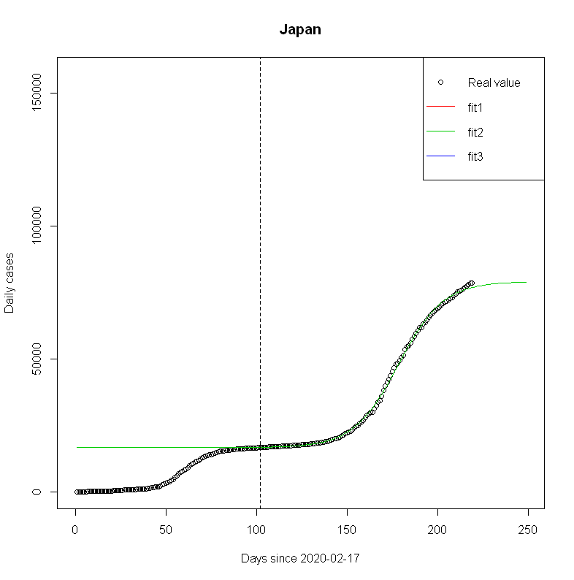
Separately Fitted Logistic model
These two fittings are separately performed.

Slide 13
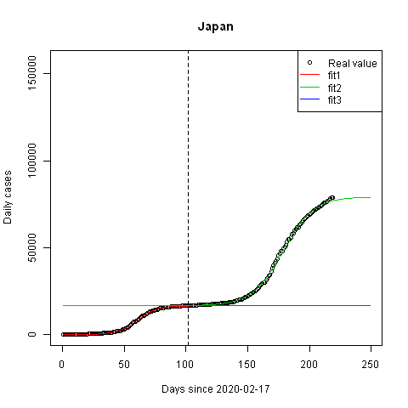
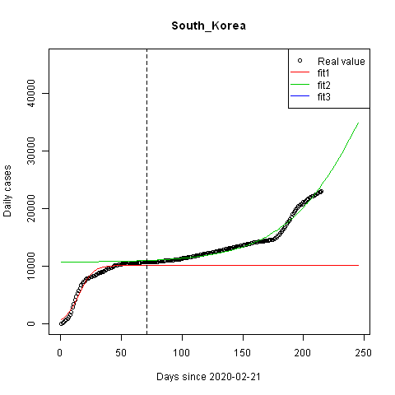
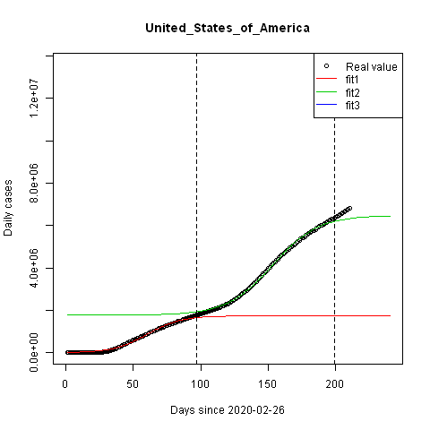
Separately Fitted Logistic model – Cumulative Cases

Slide 14
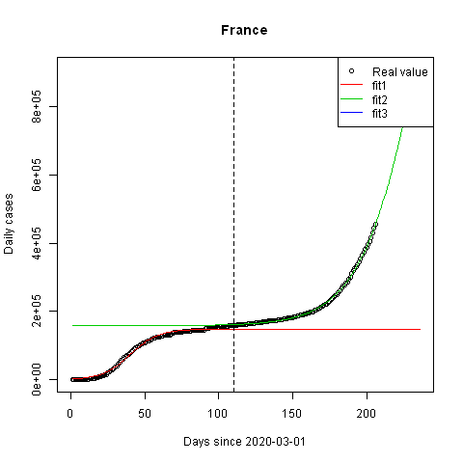
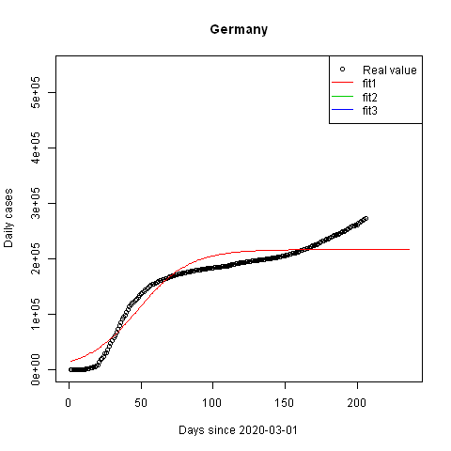
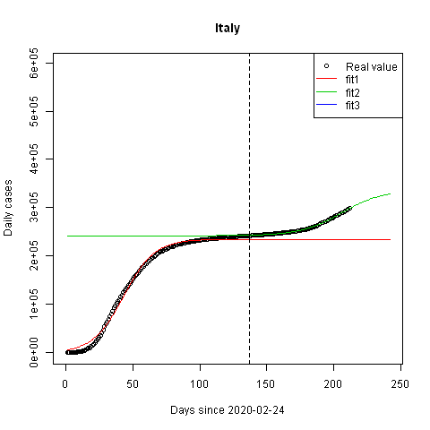
Separately Fitted Logistic model– Cumulative Cases

Slide 15
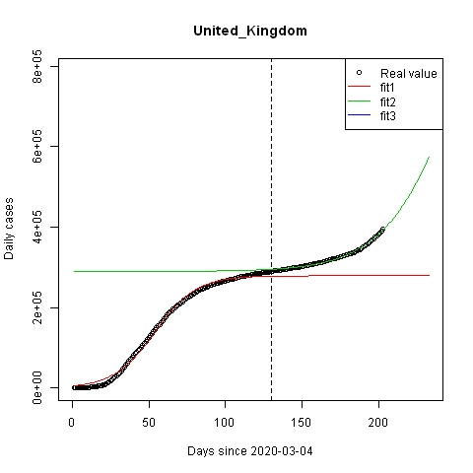
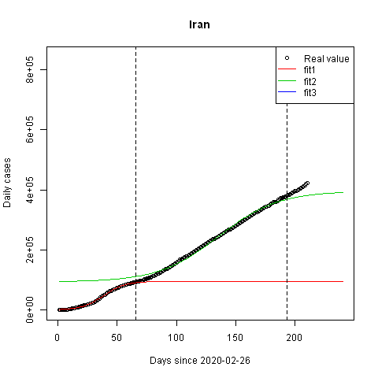
Separately Fitted Logistic model– Cumulative Cases

Slide 16
Separate vs Segmented Logistic
 |  | Separate model |  |  | Segmented model
 | # of wave | a | b | c | a | b | c
South_Korea | 1 | 10180 | 2.63 | 0.173 | 10180 | 2.63 | 0.173
 | 2 | 63366 | 7.31 | 0.027 | 281861 | 7.91 | 0.023
Japan | 1 | 16548 | 7.56 | 0.125 | 16548 | 7.56 | 0.125
 | 2 | 62543 | 14.4 | 0.081 | 62670 | 14.34 | 0.08
United_Kingdom | 1 | 278736 | 3.99 | 0.074 | 278736 | 3.99 | 0.074
 | 2 | 933522 | 10.62 | 0.042 | not fitted
France | 1 | 147973 | 4.27 | 0.106 | 147973 | 4.27 | 0.106
 | 2 | 1686893 | 11.7 | 0.05 | not fitted
Germany | 1 | 216765 | 2.66 | 0.055 | 216765 | 2.66 | 0.055
Italy | 1 | 234553 | 3.78 | 0.087 | 234553 | 3.78 | 0.087
 | 2 | 94862 | 13.41 | 0.065 | 334783 | 9.1 | 0.036
Iran | 1 | 95537 | 4.225 | 0.109 | 95537 | 4.225 | 0.109
 | 2 | 302481 | 5.4 | 0.04 | 292288 | 5.71 | 0.043
 | 3 | not fitted |  |  | 51837 | 29.35 | 0.147
China | 1 | 85095 | 7.37 | 0.199 | 85095 | 7.37 | 0.199
United_States_of_America | 1 | 1735650 | 4.94 | 0.082 | 1735650 | 4.94 | 0.082
 | 2 | 4712386 | 9.11 | 0.06 | 4756758 | 8.96 | 0.059
 | 3 | not fitted |  |  | not fitted
Canada | 1 | 102734 | 3.94 | 0.071 | 102734 | 3.94 | 0.071
 | 2 | 15732 | 19.53 | 0.138 | 19728 | 13.27 | 0.095
 | 3 | not fitted |  |  | 32263 | 19.17 | 0.099
Spain | 1 | 232863 | 4.25 | 0.121 | 232863 | 4.25 | 0.121
 | 2 | 641896 | 12.07 | 0.062 | 829985.1 | 10.51 | 0.051
Brazil | 1 | 5016064 | 5.215 | 0.037 | 5016064 | 5.215 | 0.037
Russia | 1 | 932973 | 3.96 | 0.045 | 932973 | 3.96 | 0.045
 | 2 | 155988 | 29.54 | 0.164 | 183613 | 20.64 | 0.116
India | 1 | 8895287 | 6.89 | 0.038 | 8895287 | 6.89 | 0.038
결과 비교
주요 국가 14개국에 대해서 두 모형을 적합시키고 계수를 비교
1st wave의 모수는 동일. 2nd wave부터 비교가능.
프랑스, 영구과 같이 한쪽은 적합되고 다른 한쪽은 적합되지 않는 나라들도 존재.

Slide 17
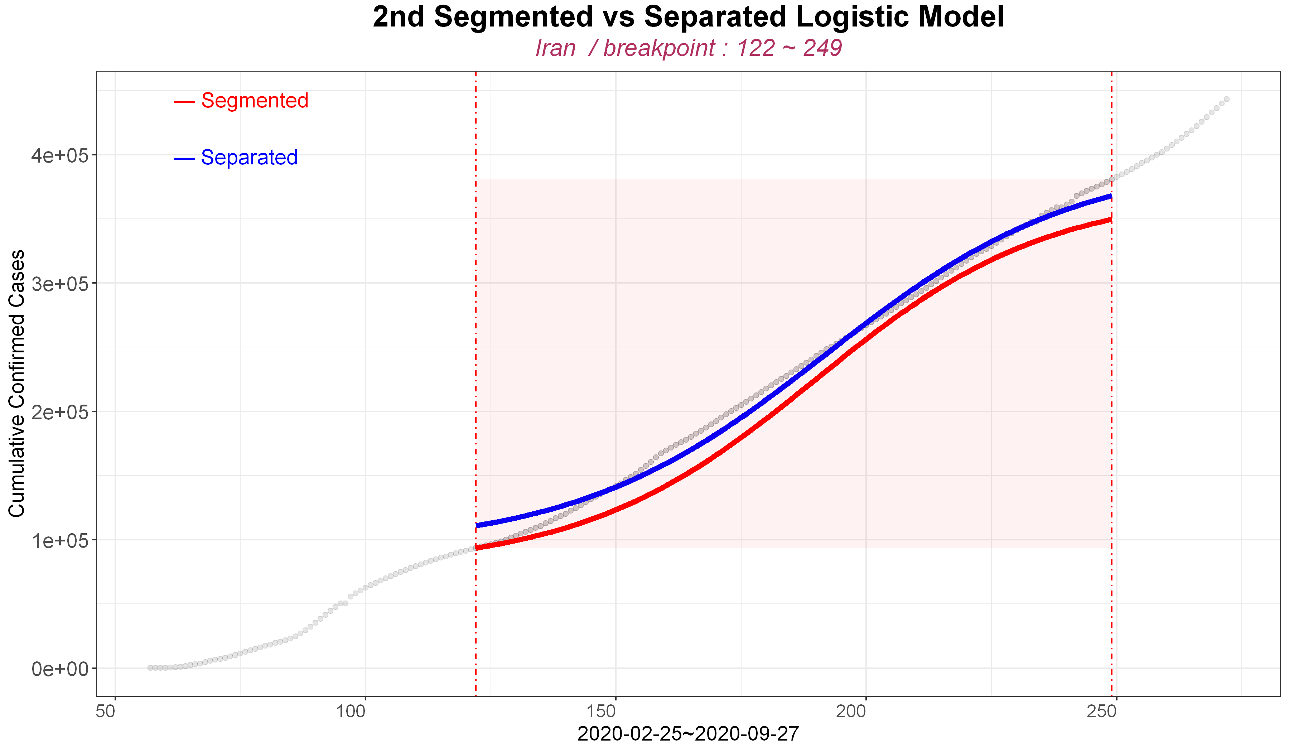
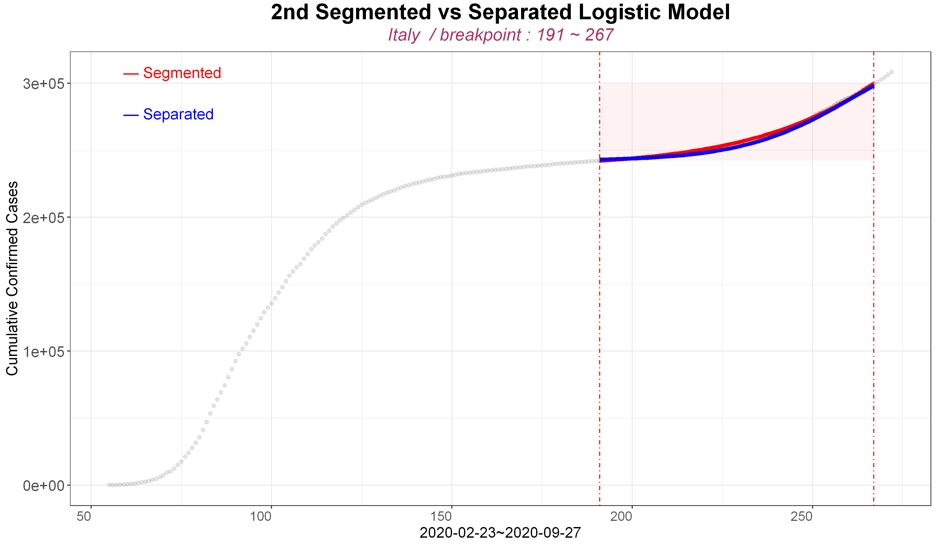
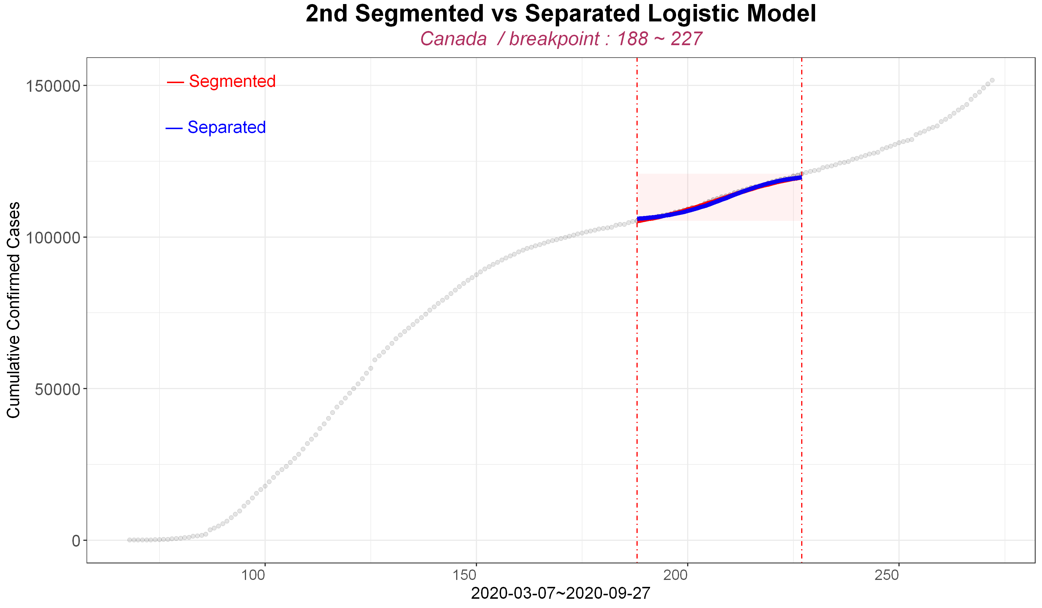
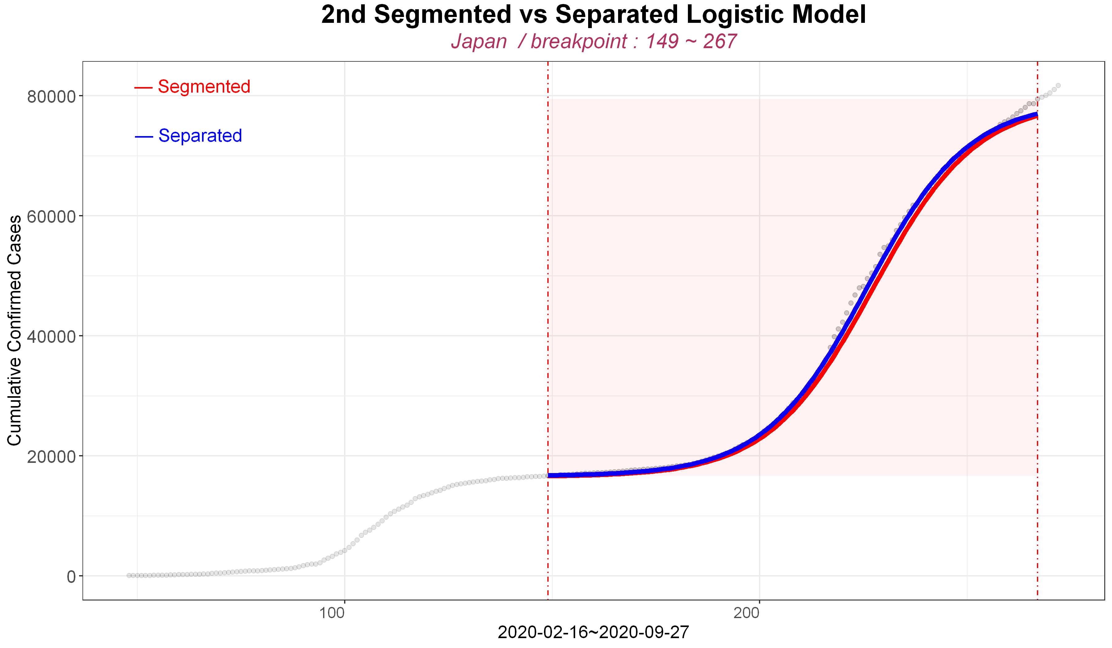
Seg vs Sep Comparison – Cumulative Cases

Slide 18
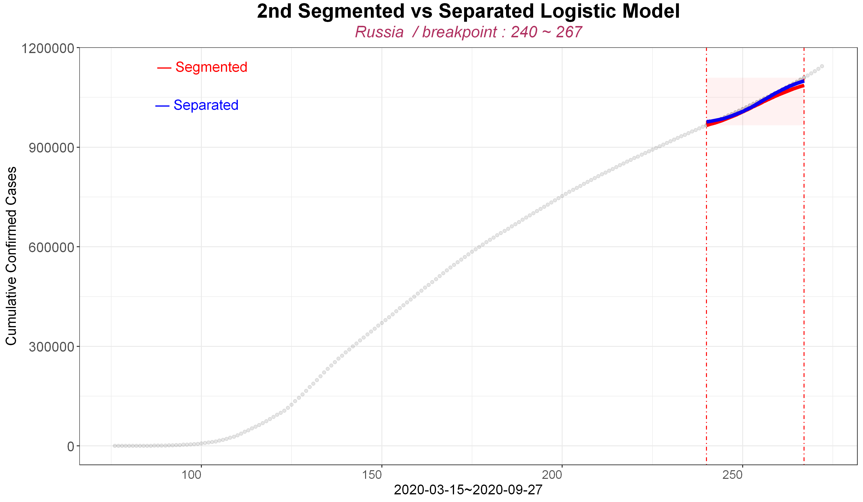
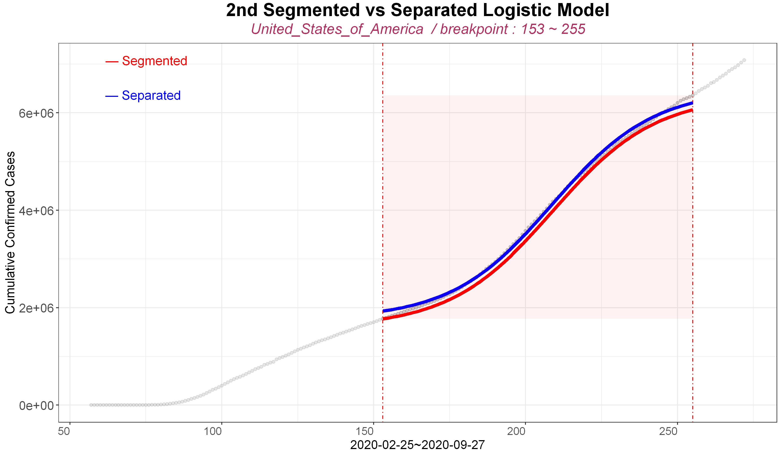
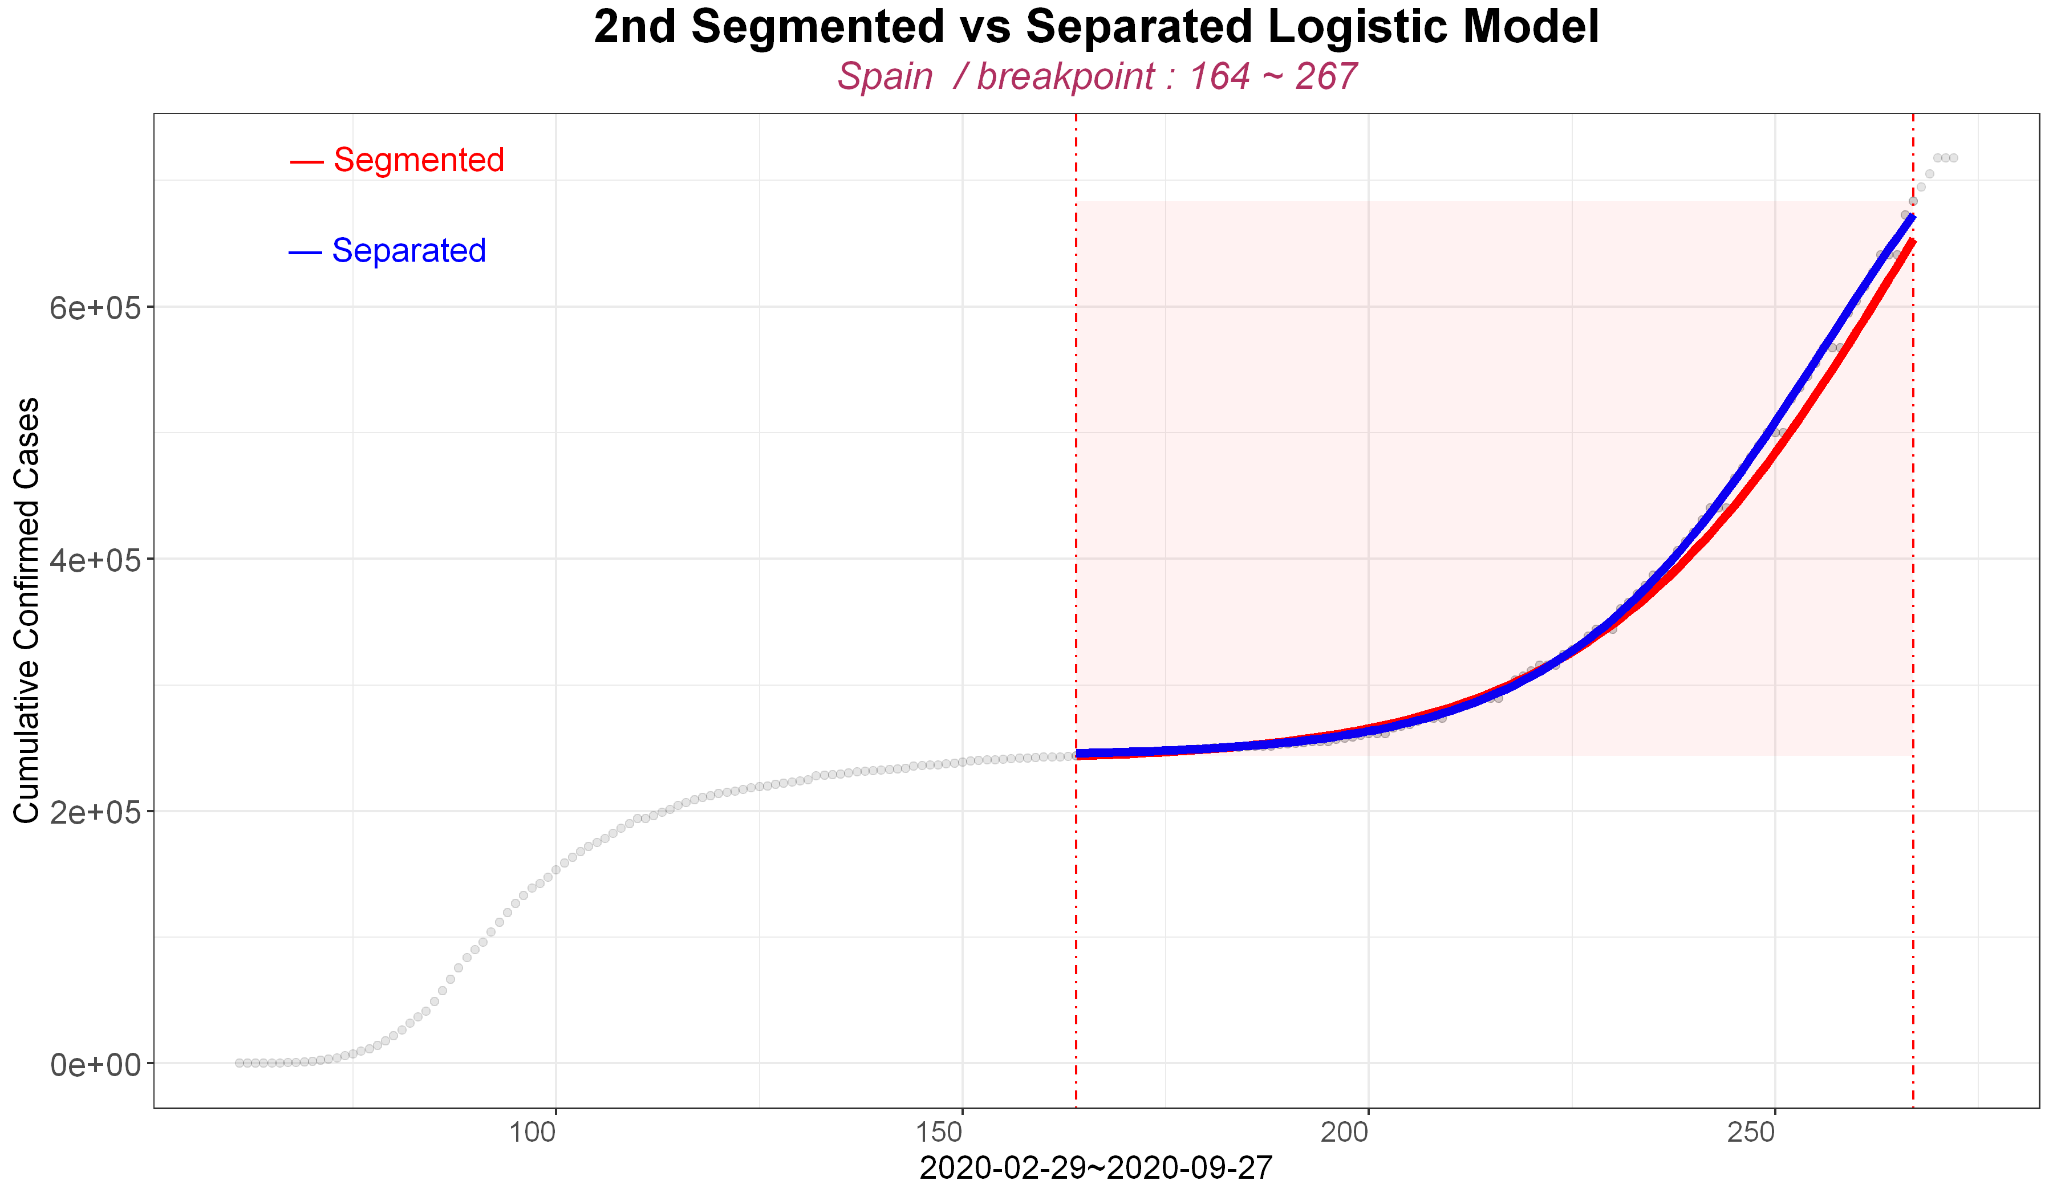
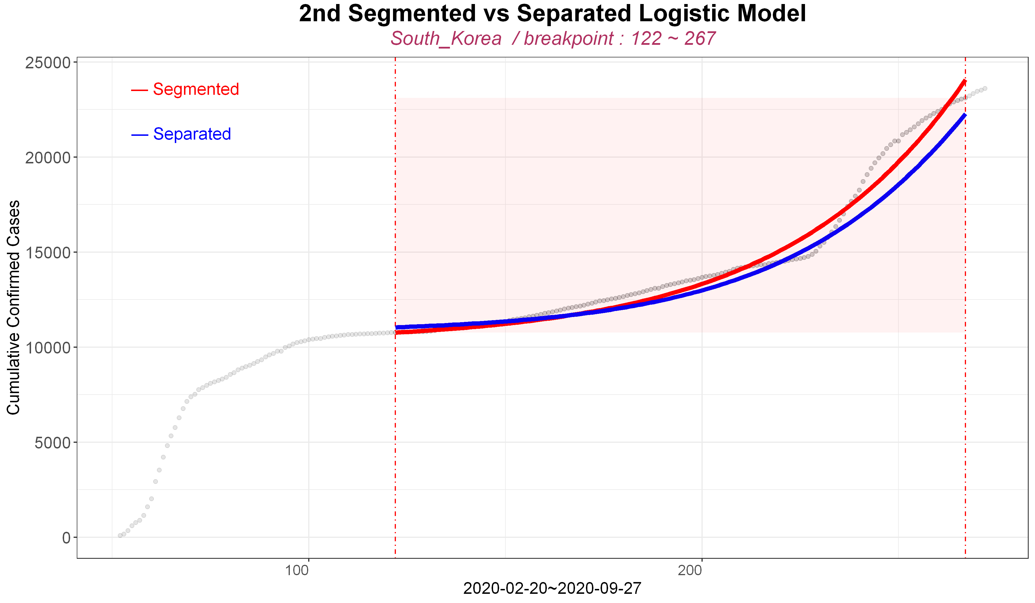
Seg vs Sep Comparison – Cumulative Cases

